Slide 1


Slide 2

27
EXPENDITURE MULTIPLIERS

Slide 3
After studying this chapter, you will be able to:
Explain how expenditure plans are determined
Explain how real GDP is determined at a fixed price level
Explain the expenditure multiplier
Explain the relationship between aggregate expenditure and aggregate demand

Slide 4
Fixed Prices and Expenditure Plans
  Keynesian model describes the economy in the very short run when prices are fixed.
  Because each firm’s price is fixed, for the economy as a whole:
  1. The price level is fixed.
  2. Aggregate demand determines real GDP.
  What determines aggregate expenditure plans?

Slide 5
Fixed Prices and Expenditure Plans
  Expenditure Plans
  The components of aggregate expenditure sum to real GDP.
  That is,
  Y = C + I + G + X – M
  Two of the components of aggregate expenditure,
  1) consumption and 2) imports, are influenced by real GDP(equivalent to income).
  So there is a two-way link between aggregate expenditure and real GDP.

Slide 6
Fixed Prices and Expenditure Plans
  Two-Way link Between Aggregate Expenditure and Real GDP
  Other things remaining the same,
  An increase in real GDP increases aggregate expenditure.
  An increase in aggregate expenditure increases real GDP.

Slide 7
Fixed Prices and Expenditure Plans
Consumption and Saving Plans
  Consumption expenditure is influenced by many factors but the most direct one is disposable income.
  Disposable income is aggregate income or real GDP, Y, minus net taxes, T.
  Call disposable income YD.
  The equation for disposable income is
  YD = Y – T

Slide 8
Fixed Prices and Expenditure Plans
  Disposable income, YD, is either spent on consumption goods and services, C, or saved, S.
  That is, YD = C + S.
  The relationship between consumption expenditure and disposable income, other things remaining the same, is the consumption function.
  The relationship between saving and disposable income, other things remaining the same, is the saving function.
  Figure 27.1 illustrates the consumption function and the saving function.

Slide 9
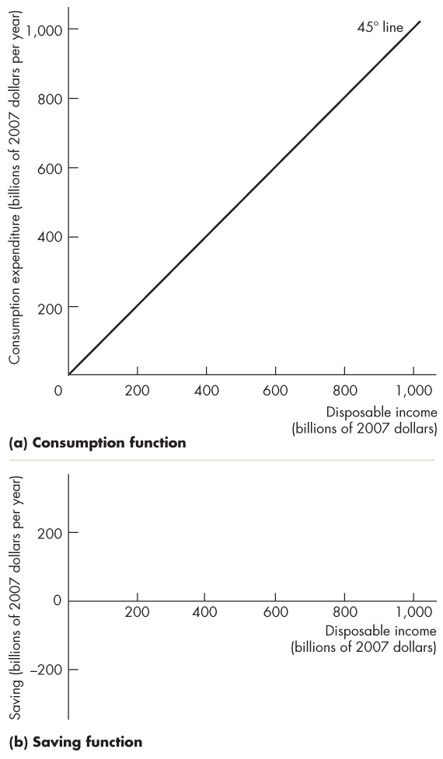
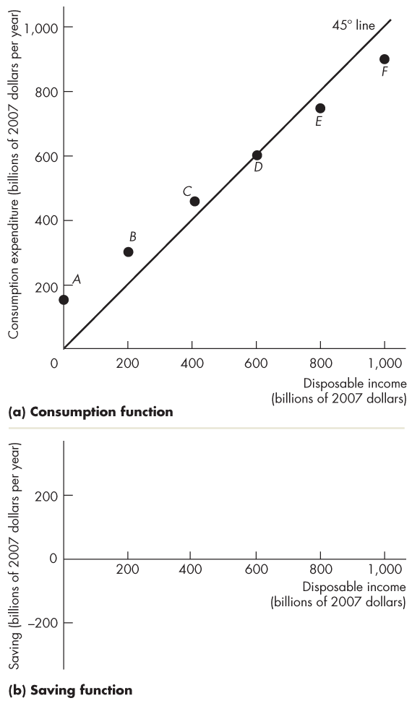
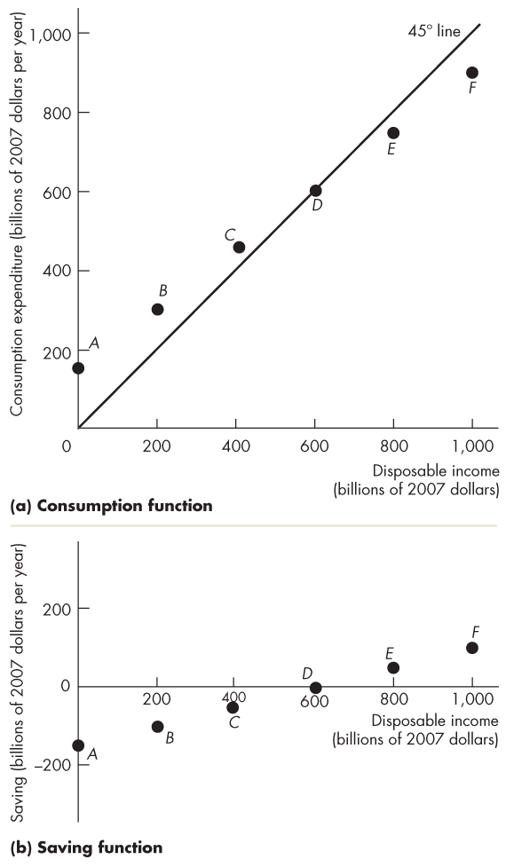
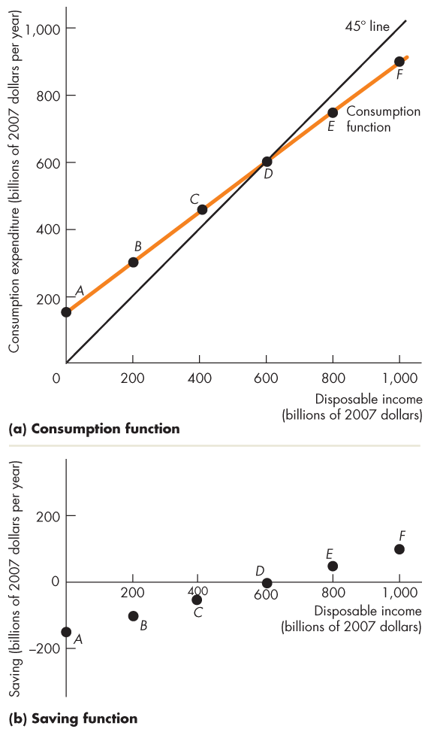
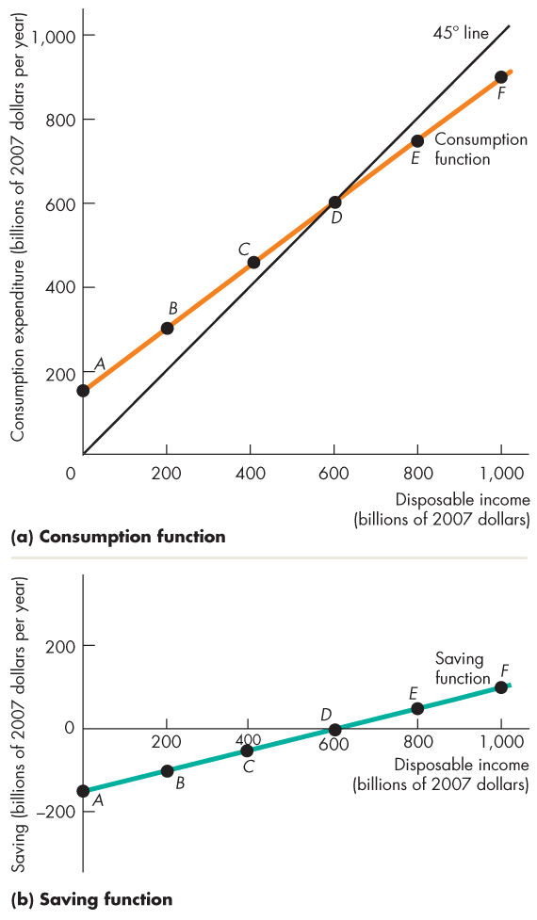
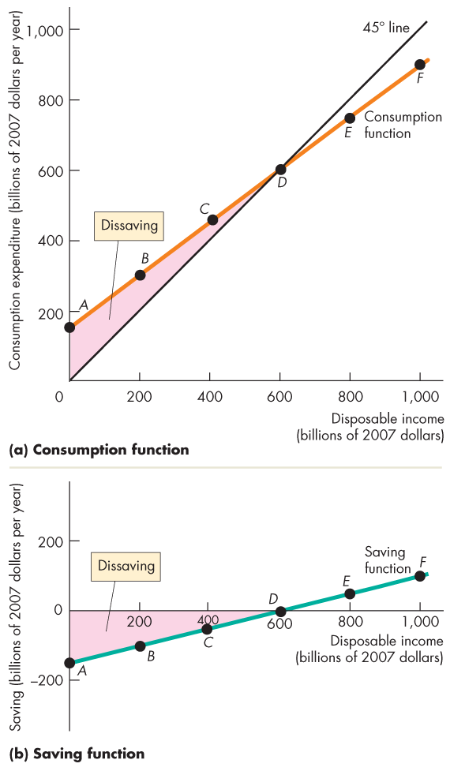
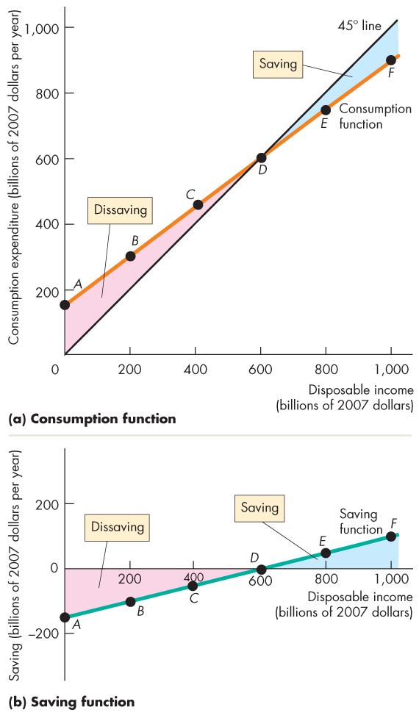
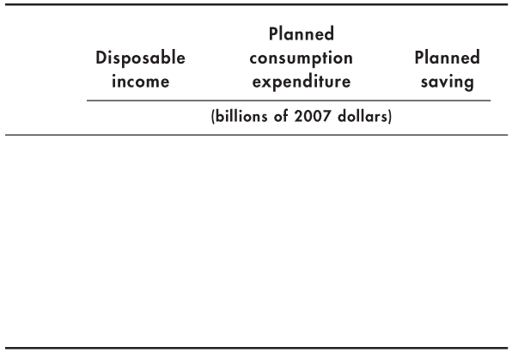
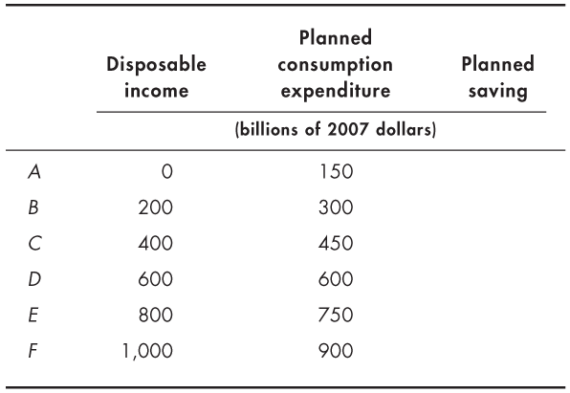
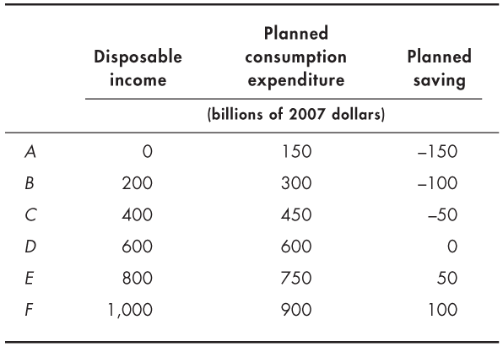
Fixed Prices and Expenditure Plans
  When consumption expenditure exceeds disposable income, saving is negative (dissaving).
  When consumption expenditure is less than disposable income, there is saving.

Slide 11
Fixed Prices and Expenditure Plans
Marginal Propensities to Consume and Save
  The marginal propensity to consume (MPC) is the fraction of a change in disposable income spent on consumption.
  It is calculated as the change in consumption expenditure, △C, divided by the change in disposable income, △YD, that brought it about.
  That is, MPC = △C ÷ △YD

Slide 12
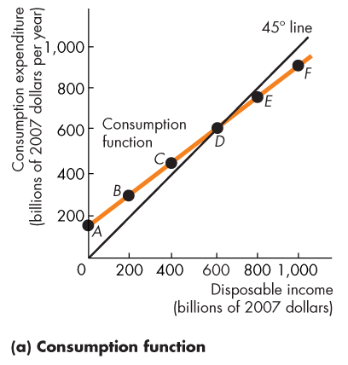
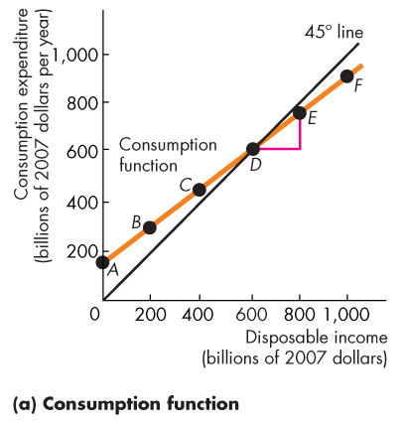
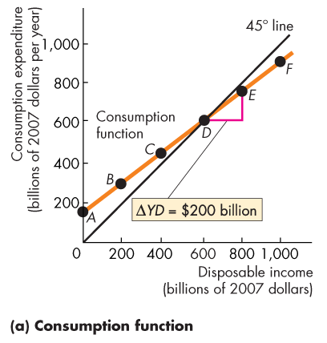
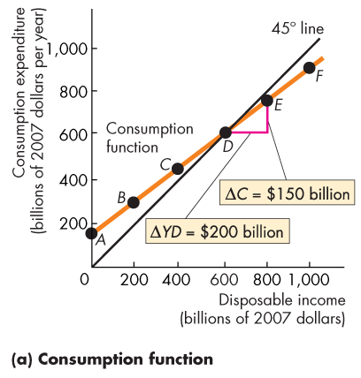
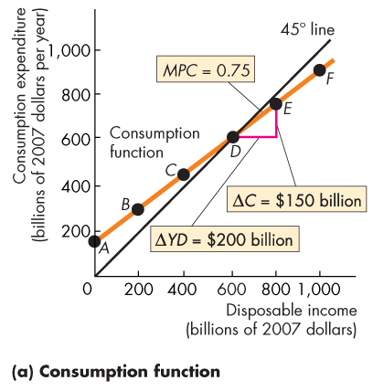
Fixed Prices and Expenditure Plans
  Figure 27.2(a) shows that the MPC is the slope of the consumption function.
  Along this consumption function, when disposable income increases by
  $200 billion, consumption expenditure increases by $150 billion.
  The MPC is 0.75.

Slide 13
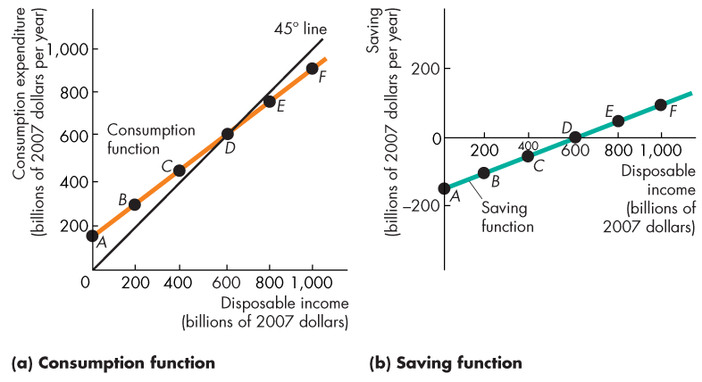
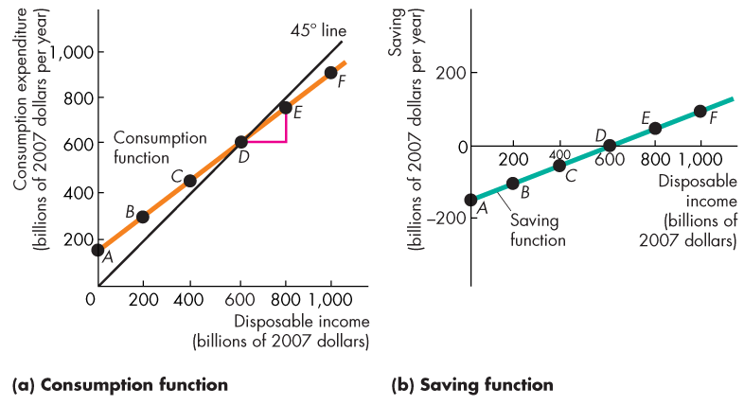
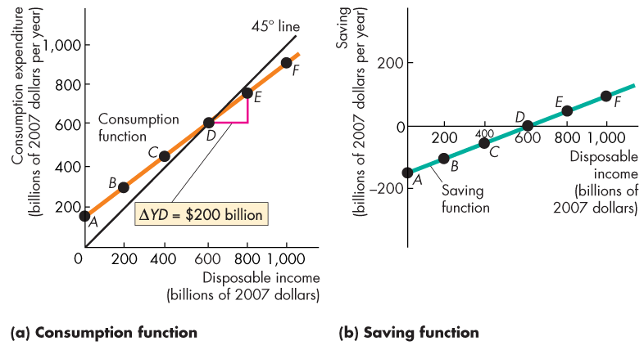
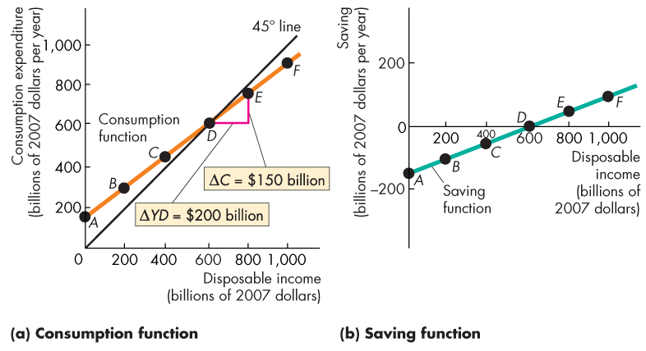
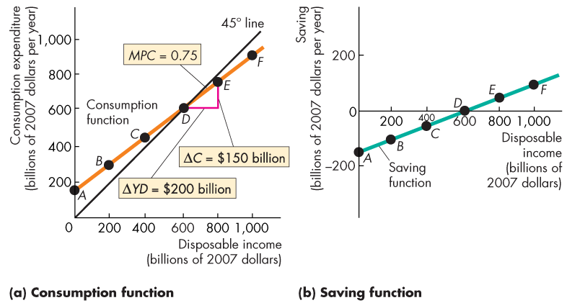

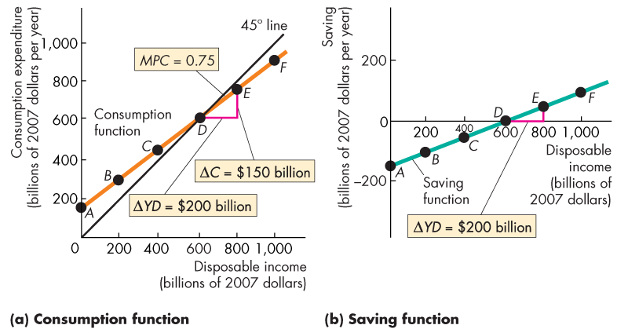
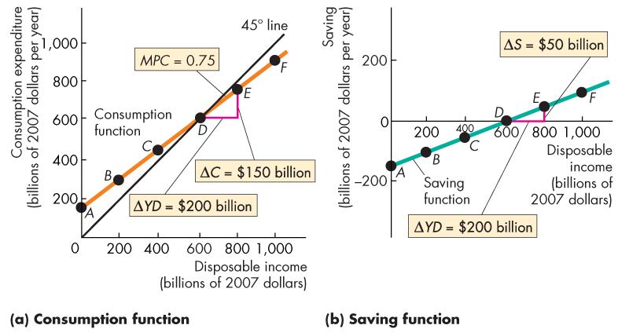
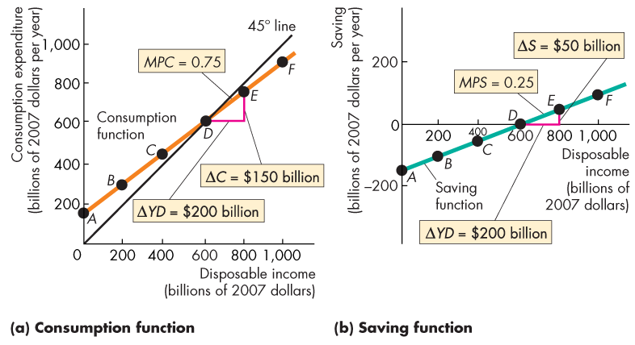

Slide 14
Fixed Prices and Expenditure Plans
  The marginal propensity to save (MPS) is the fraction of a change in disposable income that is saved.
  It is calculated as the change in saving, △S, divided by the change in disposable income, △YD, that brought it about.
  That is,
  MPS = △S ÷ △YD

Slide 15
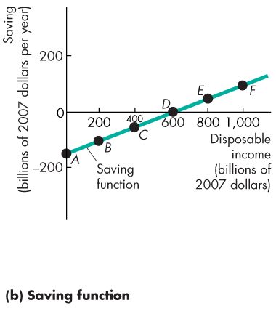
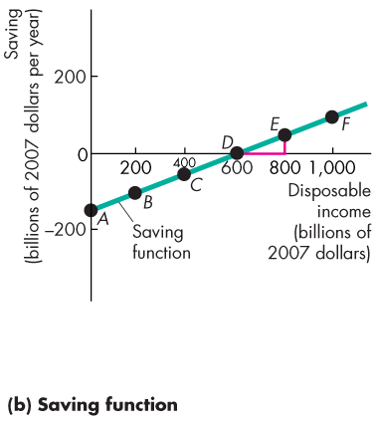
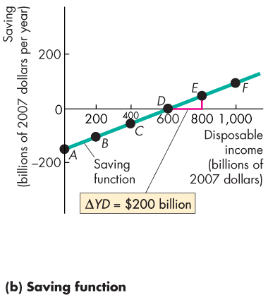
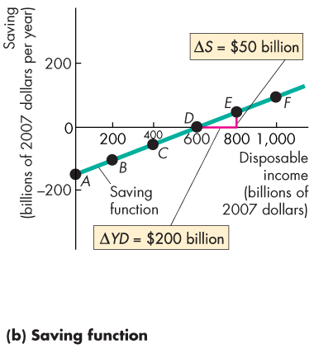
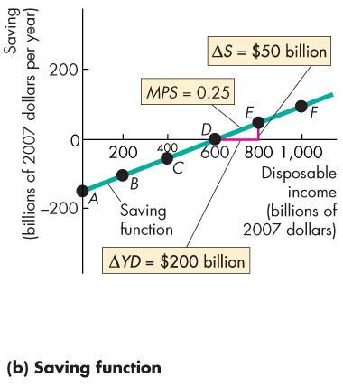
Fixed Prices and Expenditure Plans
  Figure 27.2(b) shows that the MPS is the slope of the saving function.
  Along this saving function, when disposable income increases by $200 billion, saving increases by
  $50 billion.
  The MPC is 0.25.

Slide 17
Fixed Prices and Expenditure Plans
  The MPC plus the MPS equals 1.
  To see why, note that,
  △C + △S = △ YD.
  Divide this equation by △ YD to obtain,
  △ C/ △ YD + △ S/ △ YD = △ YD/ △ YD
  or
  MPC + MPS = 1.

Slide 18
Fixed Prices and Expenditure Plans
1) Consumption as a Function of Real GDP
  Disposable income (Y - T) changes when either real GDP changes or net taxes change.
  If tax rates don’t change, real GDP is the only influence on disposable income, so consumption expenditure is a function of real GDP. C = C(Y)
  We use this relationship to determine real GDP when the price level is fixed.

Slide 19
Fixed Prices and Expenditure Plans
2) Import Function
  In the short run, Canadian imports are influenced primarily by Canadian real GDP.
  The marginal propensity to import is the fraction of an increase in real GDP spent on imports.
  If an increase in real GDP of $100 billion increases imports by $25 billion, the marginal propensity to import is 0.25.

Slide 20
Real GDP with a Fixed Price Level
  When the price level is fixed, aggregate demand is determined by aggregate expenditure plans.
  Aggregate planned expenditure is planned consumption expenditure plus planned investment plus planned government expenditure plus planned exports minus planned imports. (recall: slide 5)
  AE = C + I + G + X - M

Slide 21
Real GDP with a Fixed Price Level
  Planned consumption expenditure and planned imports are influenced by real GDP. (recall: slide 5, 6)
  When real GDP increases, planned consumption expenditure and planned imports increase. (recall: slide 5, 6)
  Planned investment plus planned government expenditure plus planned exports are NOT influenced by real GDP.

Slide 22
Real GDP with a Fixed Price Level
Aggregate Planned Expenditure
  The relationship between aggregate planned expenditure and real GDP can be described by an aggregate expenditure schedule, which lists the level of aggregate expenditure planned at each level of real GDP.
  The relationship can also be described by an aggregate expenditure curve, which is a graph of the aggregate expenditure schedule.

Slide 23
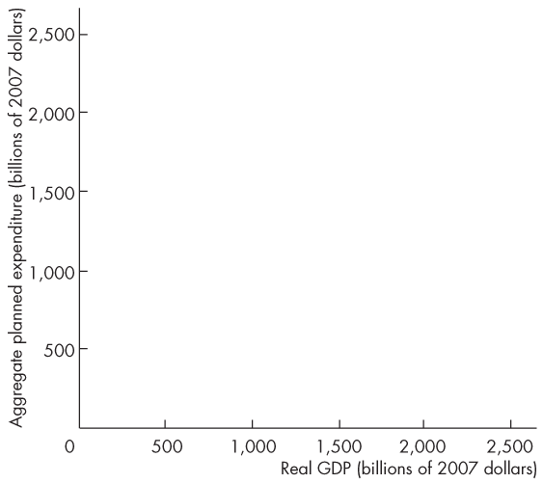
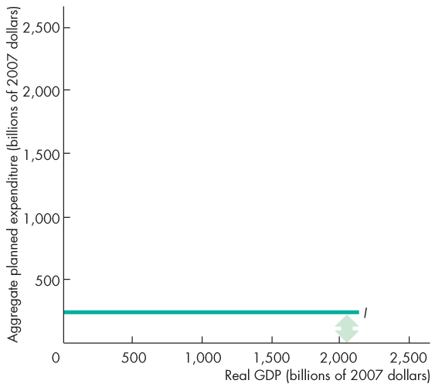
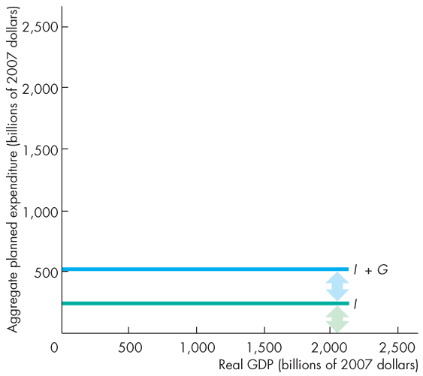
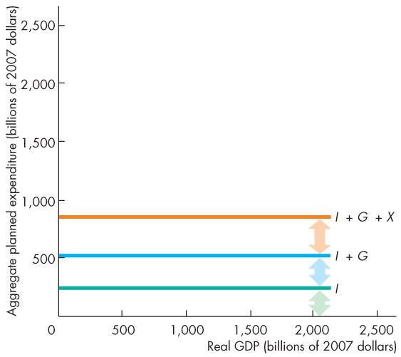
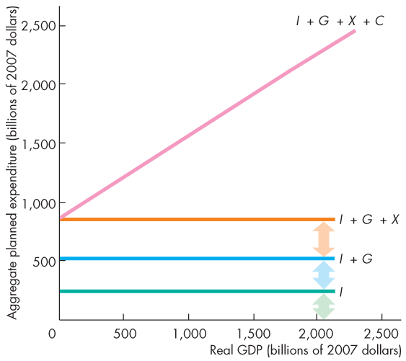
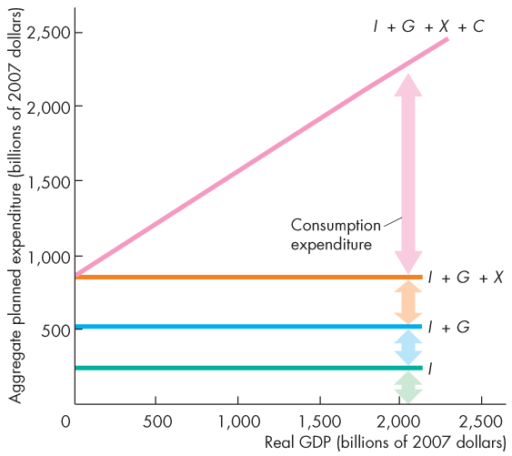
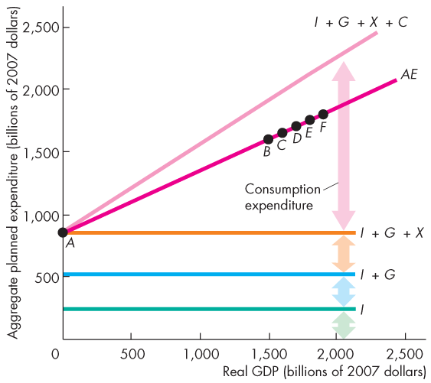
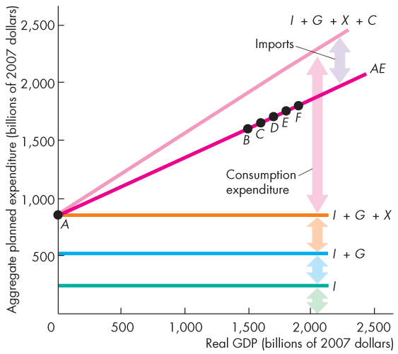
Real GDP with a Fixed Price Level
  Figure 27.3 shows how the aggregate expenditure curve (AE) is built from its components.

Slide 25
Real GDP with a Fixed Price Level
  Consumption expenditure minus imports, which varies with real GDP, is induced expenditure.(varied with real GDP)
  The sum of investment, government expenditure, and exports, which does not vary with GDP, is autonomous expenditure.(does not vary with real GDP)
  (Consumption expenditure and imports can have an autonomous component.)

Slide 26
Real GDP with a Fixed Price Level
Actual Expenditure, Planned Expenditure, and
Real GDP
  Actual aggregate expenditure is always equal to real GDP.
  Aggregate planned expenditure may differ from actual aggregate expenditure because firms can have unplanned changes in inventories.
Equilibrium Expenditure
  Equilibrium expenditure is the level of aggregate expenditure that occurs when aggregate planned expenditure equals real GDP.
  (eqilibrium will occur when the things we've planned are sold)

Slide 27
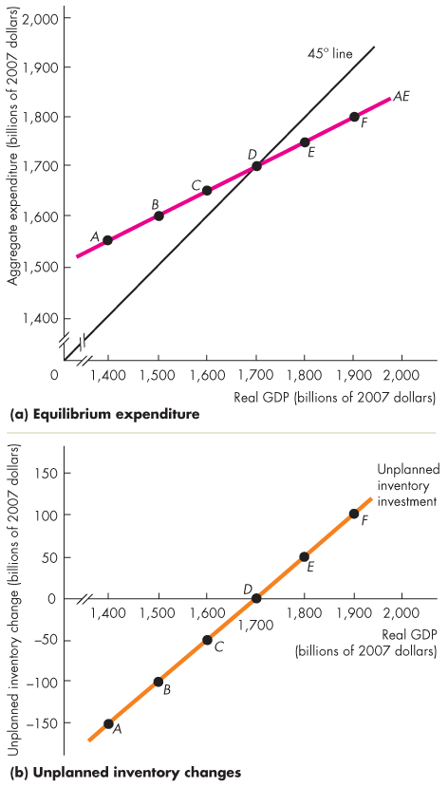
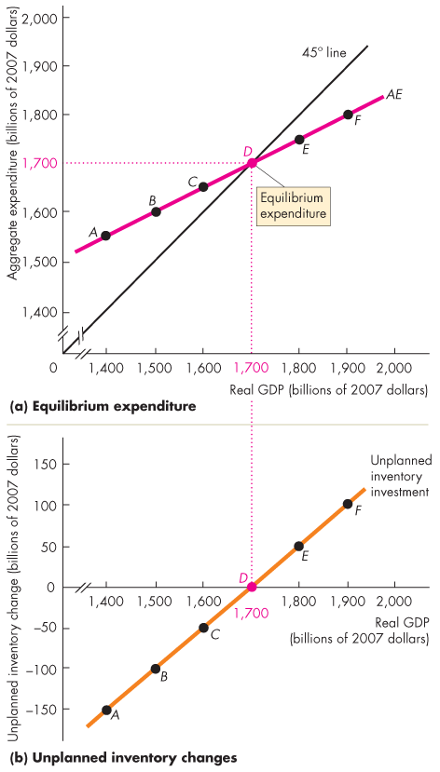
Real GDP with a Fixed Price Level
  Figure 27.4 illustrates equilibrium expenditure.
  Equilibrium occurs at the point at which the aggregate expenditure curve crosses the 45° line in part (a).
  Equilibrium occurs when there are no unplanned changes in business inventories in part (b).

Slide 28

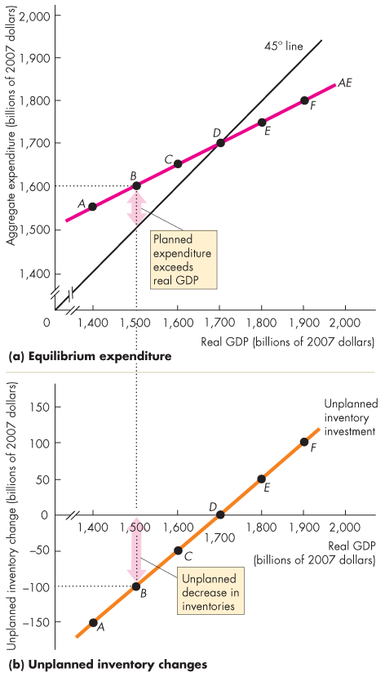
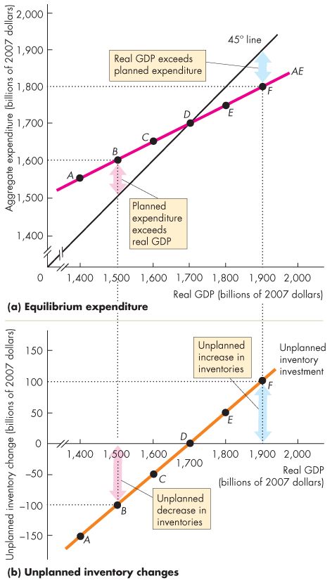
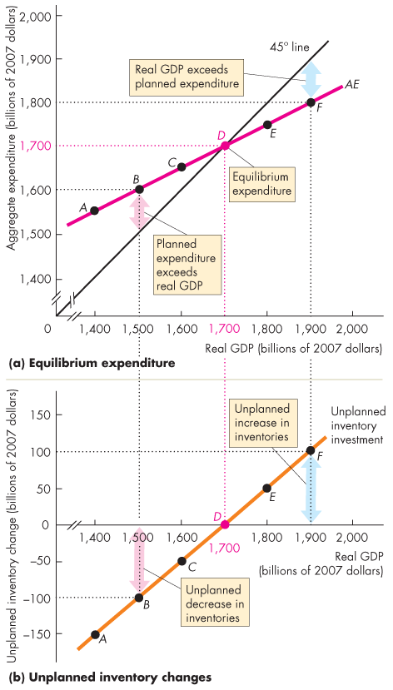

Slide 29
Real GDP with a Fixed Price Level
Convergence to Equilibrium
  If aggregate planned expenditure exceeds real GDP (the AE curve is above the 45° line), …
  there is an unplanned decrease in inventories.
  To restore inventories, firms hire workers and increase production.
  Real GDP increases.
  (when the unplanned is less than the production)
  (if ppl want 10 apples, you only have 5, you will produce more)

Slide 30
for the graph shown above
Points A-C
AE>Y
firms are depleting their inventories
Point D
AE=Y
Point E-F
inventories are decreasing
How to get to equilibrium: change production plans

Slide 31
Real GDP with a Fixed Price Level
  If aggregate planned expenditure is less than real GDP (the AE curve is below the 45° line), …
  there is an unplanned increase in inventories.
  To reduce inventories, firms fire workers and decrease production.
  Real GDP decreases.
  (ppl want 5, you have5, then the left 5 has to be put into inventory)

Slide 32
Real GDP with a Fixed Price Level
  If aggregate planned expenditure equals real GDP (the AE curve intersects the 45° line), …
  there is no unplanned change in inventories.
  So firms maintain their current production.
  Real GDP remains constant.

Slide 33
The Multiplier
I+G+X do not vary with real GDP
  When autonomous expenditure changes, so does equilibrium expenditure and real GDP.
  But the change in equilibrium expenditure is larger than the change in autonomous expenditure.
  The multiplier is the amount by which a change in autonomous expenditure is magnified or multiplied to determine the change in equilibrium expenditure and real GDP.
Meaning:
the horizontal change is larger than the vertiacal change

Slide 34
The Multiplier
The Basic Idea of the Multiplier
  An increase in investment (or any other component of autonomous expenditure) increases aggregate expenditure and real GDP.
  The increase in real GDP leads to an increase in induced expenditure.
  The increase in induced expenditure leads to a further increase in aggregate expenditure and real GDP.
  So real GDP increases by more than the initial increase in autonomous expenditure.
I or G or X
C or Imports
change in Y

Slide 35
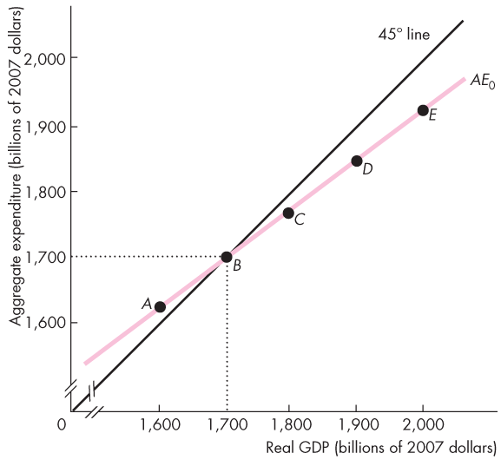
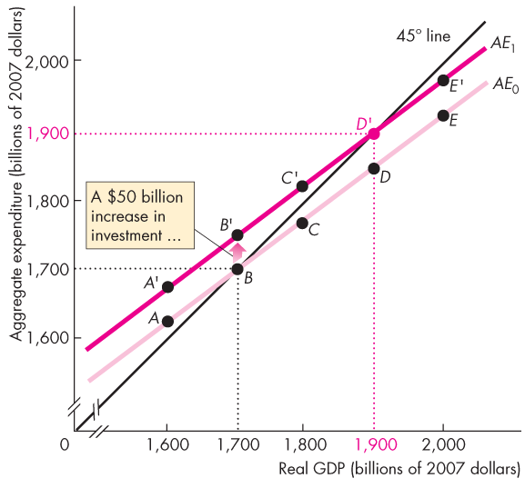
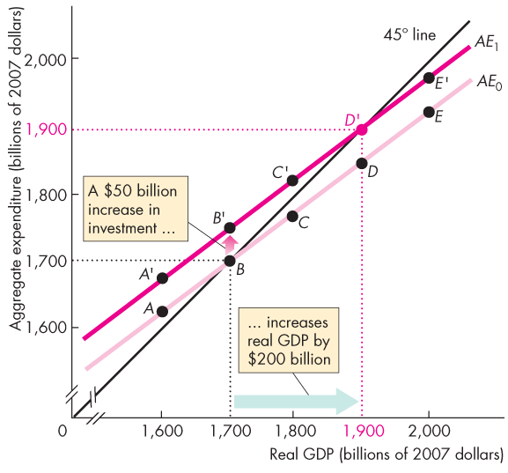
The Multiplier
  Figure 27.5 illustrates the multiplier.
  An increase in autonomous expenditure (eg. an increase in investment )brings an unplanned decrease in inventories.
  So firms increase production.
  Real GDP increases to a new equilibrium.

Slide 36
slope: 75/100
from C to D
rise over run

Slide 37
Notes on the last graph
- the increase in investment shifts the AE curve upward
- the size of the vertical shift is equal to the increase in investment
Note: the slope of the AE curve is 0.75

Slide 38
The Multiplier
Why Is the Multiplier Greater than 1?
  The multiplier is greater than 1 because an increase in autonomous expenditure induces further increases in aggregate expenditure.
The Size of the Multiplier
  The size of the multiplier is the change in equilibrium expenditure divided by the change in autonomous expenditure.
  multiplier: (change in equilibrium expenditure)/(change in autonomous expenditure)=change in Y/change in A

Slide 39
The Multiplier
The Multiplier and the Slope of the AE Curve
  The slope of the AE curve determines the magnitude of the multiplier:
  Multiplier = 1 ÷ (1 – Slope of AE curve)
  If the change in real GDP is ΔY, the change in autonomous expenditure is ΔA, and the change in induced expenditure is ΔN, then
  Multiplier = ΔY ÷ ΔA

Slide 40
The Multiplier
  To see why the multiplier = 1 ÷ (1 – Slope of AE curve), begin with the fact that:
  ΔY = ΔN + ΔA
  But
  Slope of AE curve = ΔN ÷ ΔY
  so,
  ΔN = (Slope of AE curve x ΔY)
  Now replace ΔN in the first equation
  ΔY = (Slope of AE curve x ΔY) + ΔA

Slide 41
The Multiplier
  ΔY = (Slope of AE curve x ΔY) + ΔA
  Re-arrange as
  (1 − Slope of AE curve) x ΔY = ΔA
  and
  ΔY = ΔA ÷ (1 − Slope of AE curve)
  Multiplier = ΔY ÷ ΔA
  So Multiplier = 1 ÷ (1 − Slope of AE curve)

Slide 42
The Multiplier
  With the numbers in Figure 27.5, the slope of the AE curve is 0.75, so the multiplier is
  ΔY ÷ ΔA = 1 ÷ (1 − 0.75) = 1 ÷ (0.25) = 4.
  When there are no income taxes and no imports, the slope of the AE curve equals the marginal propensity to consume, so the multiplier is
  Multiplier = 1 ÷ (1 − MPC).
  But 1 – MPC = MPS, so the multiplier is also
  Multiplier = 1 ÷ MPS.

Slide 43
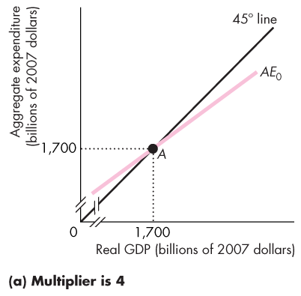
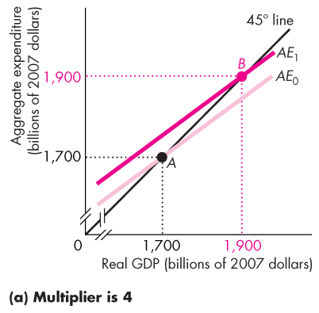
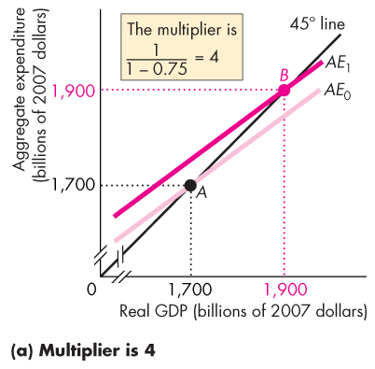
The Multiplier
Imports and Income Taxes
  Both imports and income taxes reduce the size of the multiplier.
  Figure 27.6 shows how.
  In part (a) with no taxes or imports, the slope of the AE curve is 0.75 and the multiplier is 4.

Slide 44
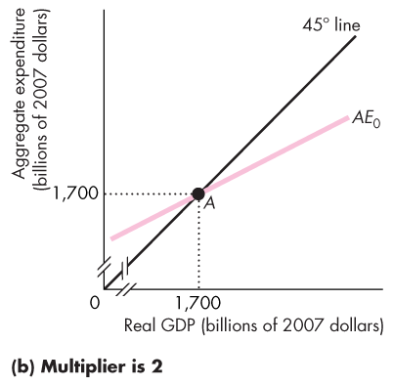
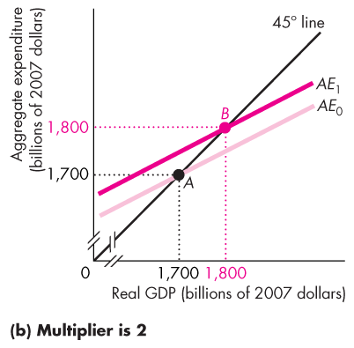
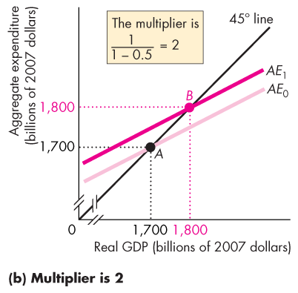
50
100

Slide 45
The Multiplier
  In part (b), with taxes and imports, the slope of the AE curve is 0.5 and the multiplier is 2.

